Slide 1
Data Hackathon 2019-11
Vogue Digital Modeling
Jennifer S., Matthew L., Sonal M.

Slide 2

“You got 8 shots, do not miss your chance to blow, this opportunity comes, 8 times in a lifetime”

Slide 3
Goal
Our main goal is to predict the probability of customer in subscribing to Term Deposit
Approach
Built Logistic Regression Model

Slide 4
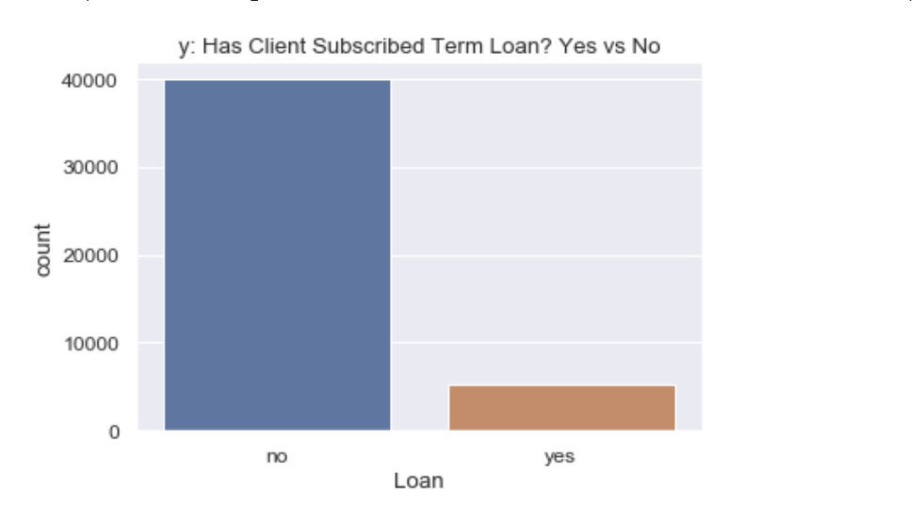
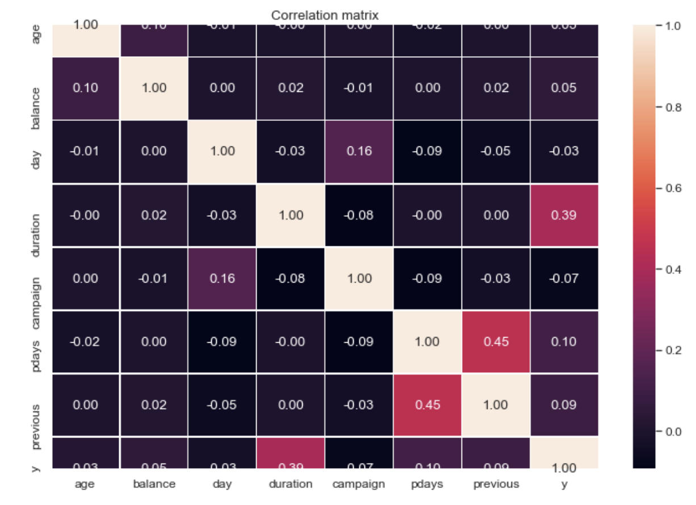
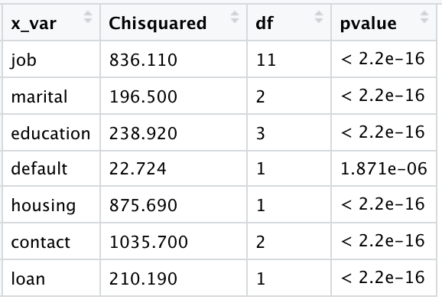
Correlation & Chi Squared Test for Independent Variables in Relation to The Dependent variables(y)
Yes = 11.70%
No = 88.30%

Slide 5
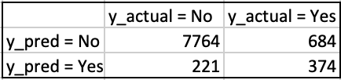
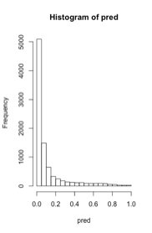
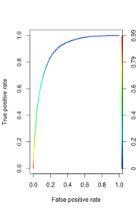
MODEL 1
Accuracy = 89.99%
Significant Variables:
housing_yes
loan_yes
campaign
balance
duration
Histogram of predicted values
ROC
Notes:
So after data cleaning and taking care of the categorical variables, we built a logistic regression model to get the baseline accuracy BUT it surprisingly performed really well..

Slide 6
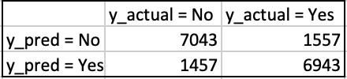
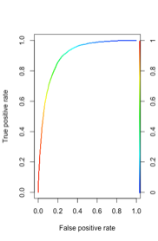
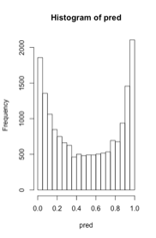
MODEL 2: Generate Synthetic Samples to Handle Imbalance Data
Significant Variables:
job_student
marital_married
job_admin
job_retired
balance
duration
Accuracy = 82.27%
Histogram of predicted values
ROC
Notes:
Although the accuracy dropped but the quality of the overall model improved in terms of no just the variables that came out to be significant but also in terms of the prediction capacity - it predicted for yes’s too

Slide 7
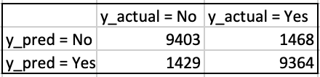
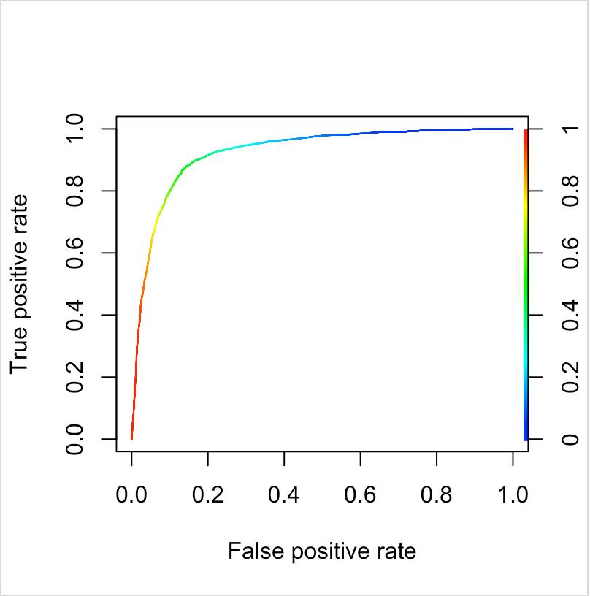
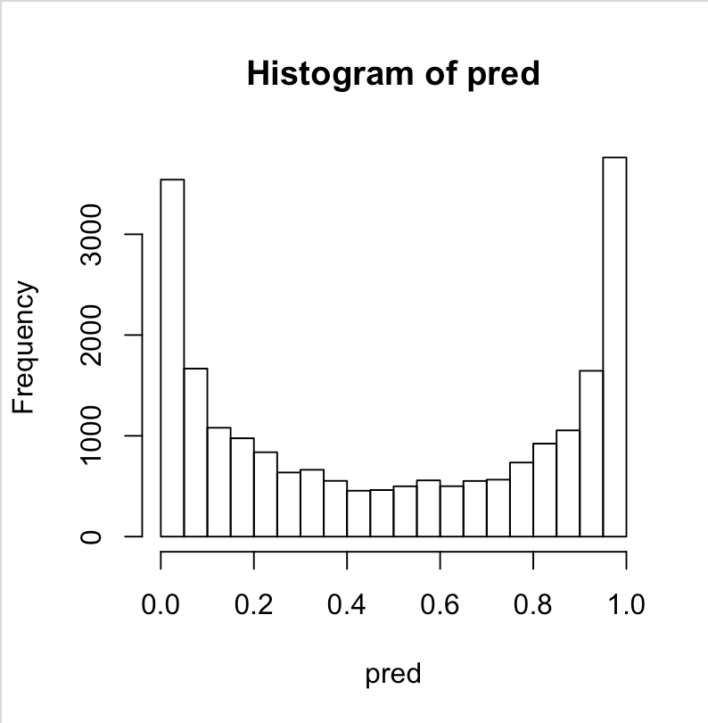
MODEL 3: New Customers
Significant Variables:
Age
Balance
Duration
jobs - retired, student, blue_collar
marital_married
Accuracy = 86.63%
ROC
Histogram of predicted values

Slide 8

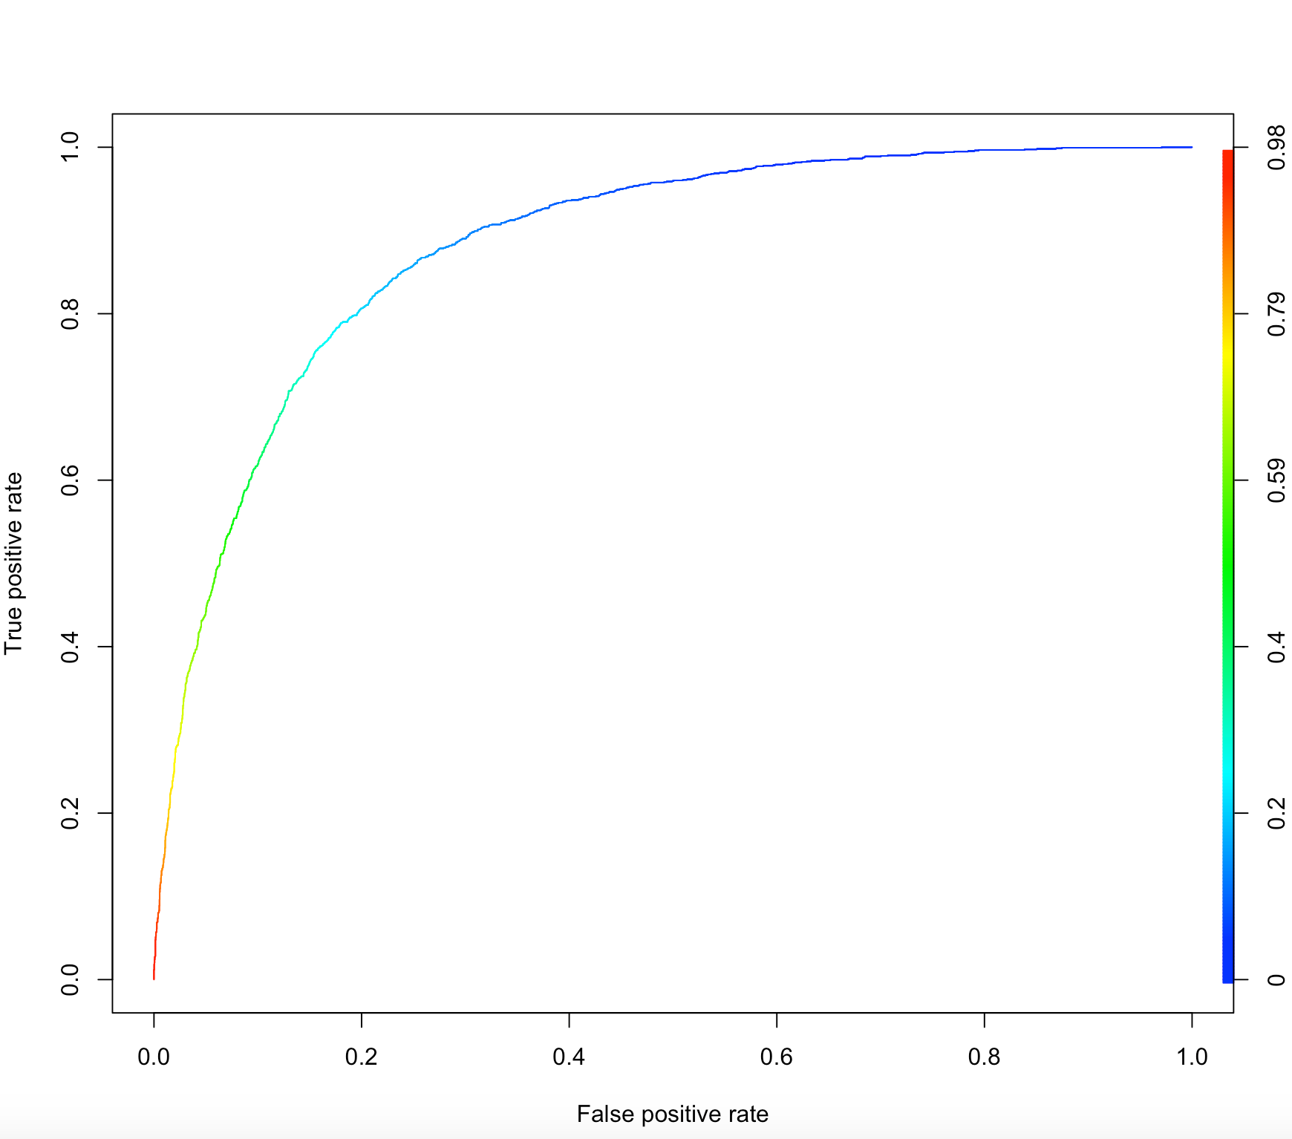
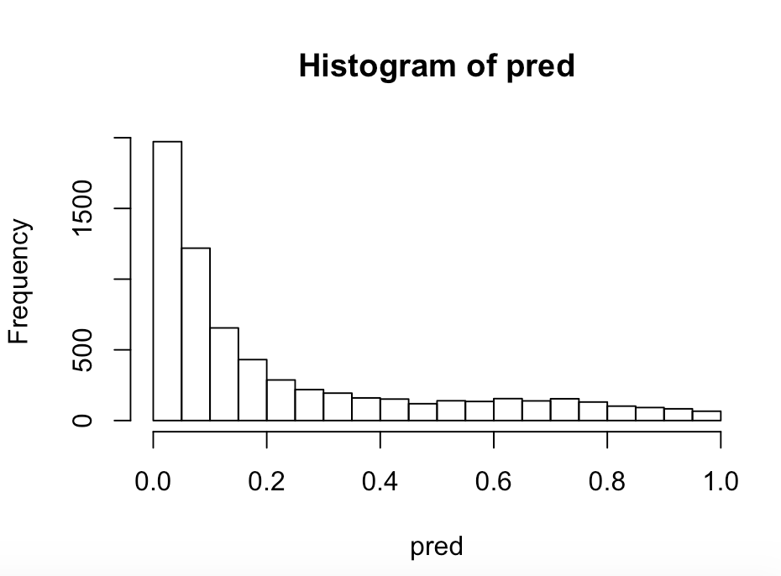
MODEL 4: Old Customer
Significant Variables:
housing_yes
loan_yes
campaign
balance
duration
Accuracy = 83.69%
ROC
Histogram of predicted values
Notes:
-Smaller sample of 6605 to train the model

Slide 9
Key Takeaways
Accuracy is not the only measure of how good the model is
Should assess the quality of the model and improvise
Ensure that the data is not imbalanced
Create segments of similar customers using affinity clustering or k-means
Create separate model for each segment to capture different customer behaviour - there is no such thing as an average customer and personalisation is the key!

